Slide 1

AI Readiness Assessment Standard Operating Procedure
Tableau Development
February 2022

Slide 2




Table of Contents
File System & Development
File locations and checklist to get started
File Setup & Data Connection
Local computer requirements and connection to Snowflake
Filters
Tableau filter configurations
Enterprise Data Strategy
Data Visualizations
Development instructions for text and data visualizations
DATA
Data Engineering

Slide 3

Tableau Development
File System &
Development Checklist

Slide 4


Tableau File System
Versions of AI360 workbooks storage locations and versions.
File Locations
Deloitte Internal Server:
Current workbook for viewing by end users. Connected to locally packaged mock data.
AI360 Deloitte Github:
Archival versions of Tableau workbook
AI Readiness text Excel file
Mock data CSV file
Tableau Development Documentation (this document)
Notes:
DATA
https://www.forbes.com/sites/tomcoughlin/2018/11/27/175-zettabytes-by-2025/#6c8999b75459
ROI
https://fortune.com/2020/01/24/ai-ibm-human-resources/
National Priority
https://www.fedscoop.com/national-ai-initiative-office-launched/

Slide 5
Tableau Development Checklist
To utilize the AI360 Tableau notebook and connect it to live data, there are some critical actions to operationalize the dashboard.
Critical Actions Checklist
Critical Actions are items that must be completed or reviewed. They are indicated on the top right corner of instruction pages in this guide as CRITICAL ACTION
Install the SnowflakeODBC Driver for Tableau to connect to Snowflake
Switch data source from the Mock Data to live Snowflake data
Review Organization data and use the Tableau grouping function to group and name Organization
Notes:
DATA
https://www.forbes.com/sites/tomcoughlin/2018/11/27/175-zettabytes-by-2025/#6c8999b75459
ROI
https://fortune.com/2020/01/24/ai-ibm-human-resources/
National Priority
https://www.fedscoop.com/national-ai-initiative-office-launched/

Slide 6
Tableau Development
File Setup & Data Connection

Slide 7


File Setup | System Requirements
CRITICAL ACTION
Software and data connections required to run live report
System Requirements
Tableau Desktop Version 2020.3
Snowflake Driver
Snowflake Account Access (username and password)

Slide 8
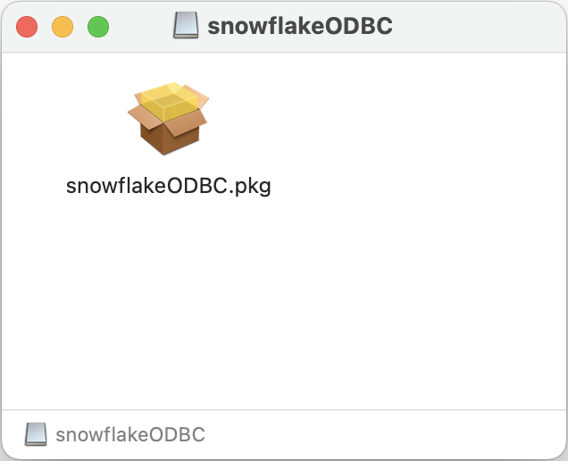
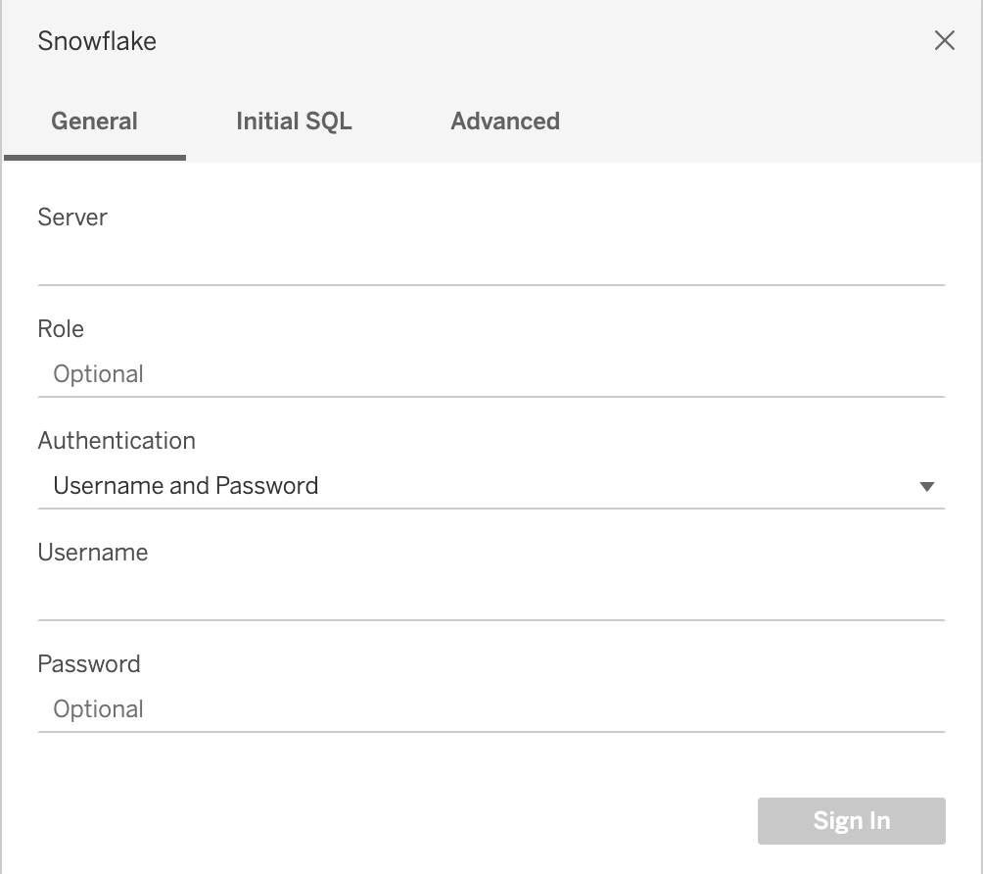
Connect to Data | Snowflake Driver
CRITICAL ACTION
Log into Snowflake from Tableau
Snowflake Driver Install
First request access to the AI360 Snowflake environment.
Gather the server location, user role, user name, and password.
In order to connect Tableau to Snowflake, download and install the SnowflakeODBC driver from Tableau.
Authenticate with user name and password.
https://help.tableau.com/current/pro/desktop/en-us/examples_snowflake.htm
*These instructions were originally prepared for and tested on a MacOS.
SnowflakeODBC driver installation.
Initial Snowflake connection required info:
Server location
User Role (User type as listed in Snowflake)
Authentication method: Username and Password
Username
Password

Slide 9
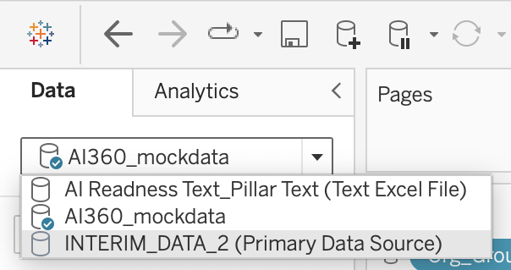
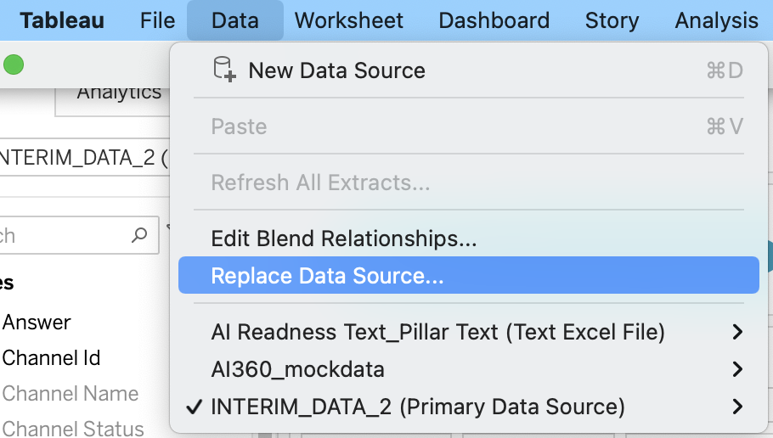
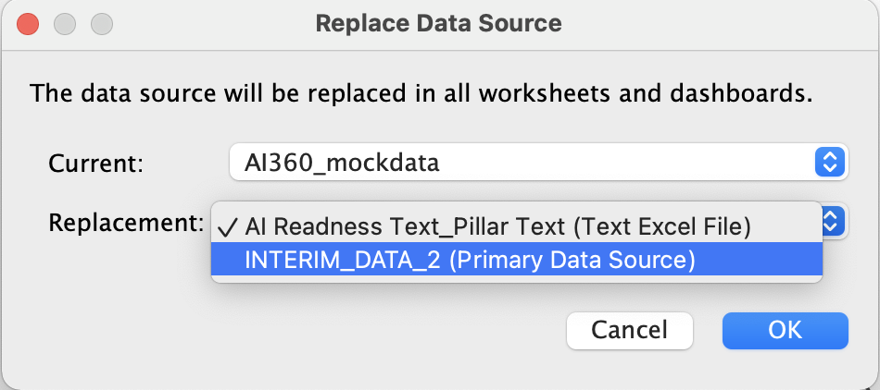
Connect to Data | Data Source
CRITICAL ACTION
Change data source from default mock data to Snowflake connection.
Change Data Source
By default the notebook is set to read a local csv file named “AI350_mockdata”.
To read in live data, connect the notebook to Snowflake.
Navigate to the ”Survey Responses” sheet from Dash 1 dashboard. Check the data source from the L hand data panel.
Navigate to the Tableau “Data” menu and select “Replace Data Source”.
Replace current “AI360_mockdata” with “INTERIM_DATA_2 (Primary Data Source)” from Snowflake
Default data source for charts is set to AI360_mockdata. Blue check mark indicates current data source for a sheet.
Select “Replace Data Source…” from the Data menu
Replace current “AI360_mockdata” with “INTERIM_DATA_2 (Primary Data Source)” from Snowflake

Slide 10
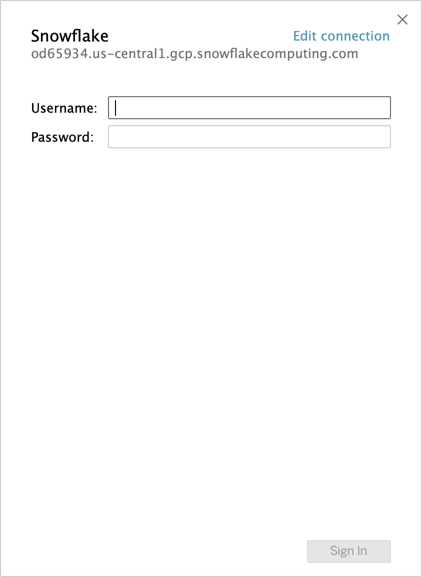
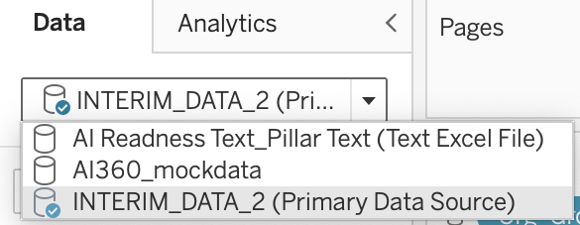
Connect to Data | Data Source
CRITICAL ACTION
Connect to Snowflake from Tableau
Log Into Snowflake
Once you replace the mock data with INTERIMD_DATA_2 (Primary Data Source), you will be prompted to connect to your Snowflake account through a pop -up panel
Data source for a sheet should have a blue check mark o “INTERIM_DATA_2 (Primary Data Source)” when connected to Snowflake
Data Sources and Functions Three built in data sources
AI360_mockdata | Local cvs data file packaged with notebook. Default data source
INTERMIM_DATA_2 (Primary Data Source) | Snowflake connected live data source. Requires account log-in.
AI Readiness Text_Pillar (Text Excel File) | Local Excel text data file packaged with notebook containing description of the pillars and readiness tier.
Log in pop-up panel for Snowflake connection.

Slide 11
Tableau Development
Filters

Slide 12
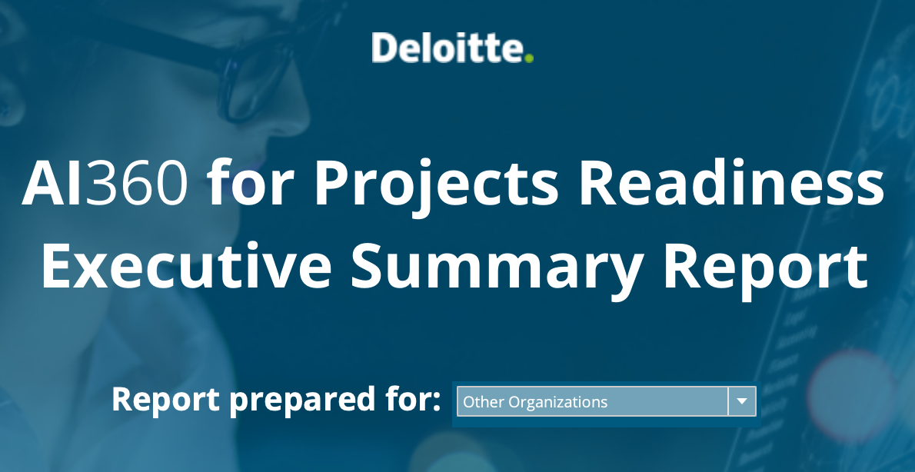
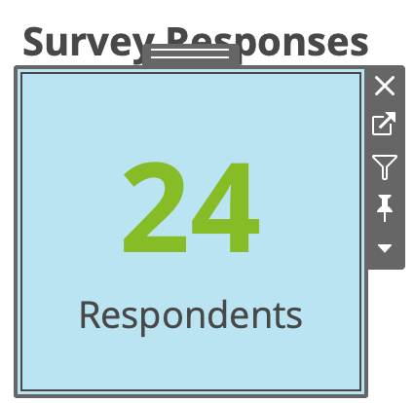
Filters | Organizations Names
CRITICAL ACTION
Using Tableau’s group function to edit organization name data.
Group Organization Names
This is a manual process to create categorical options for the drop down filter on Dashboard 1 called ‘Report prepared for:”
The filter is linked to the KPI_Responses sheet displayed on Dashboard 1
The source data is the “Organization” data column from Snowflake INTERIM_DATA_2
The existing data source for the filter is the grouped version of the organization data called “Org_Group”
Check “Org_Group” for updates and make edits
The dropdown “Report prepared for:” menu on Dashboard 1 can be edited from the Survey Responses KPI sheet.
Filter as it appears at the top of Dashboard 1.

Slide 13
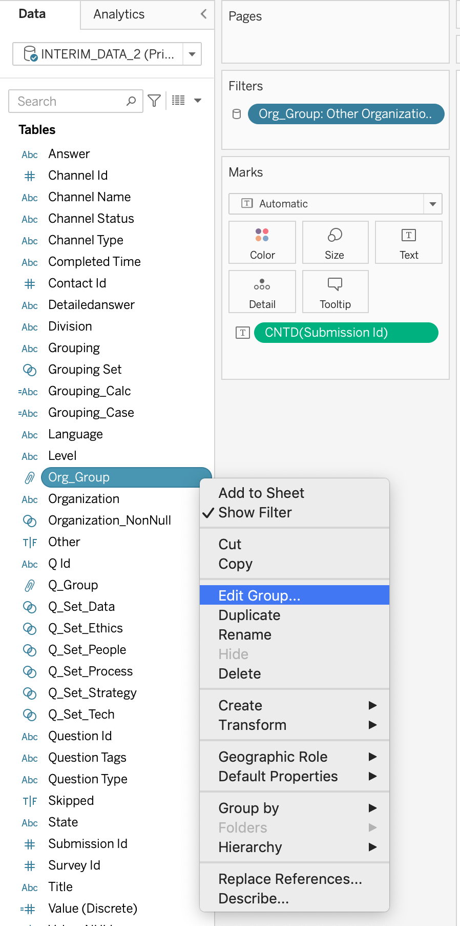
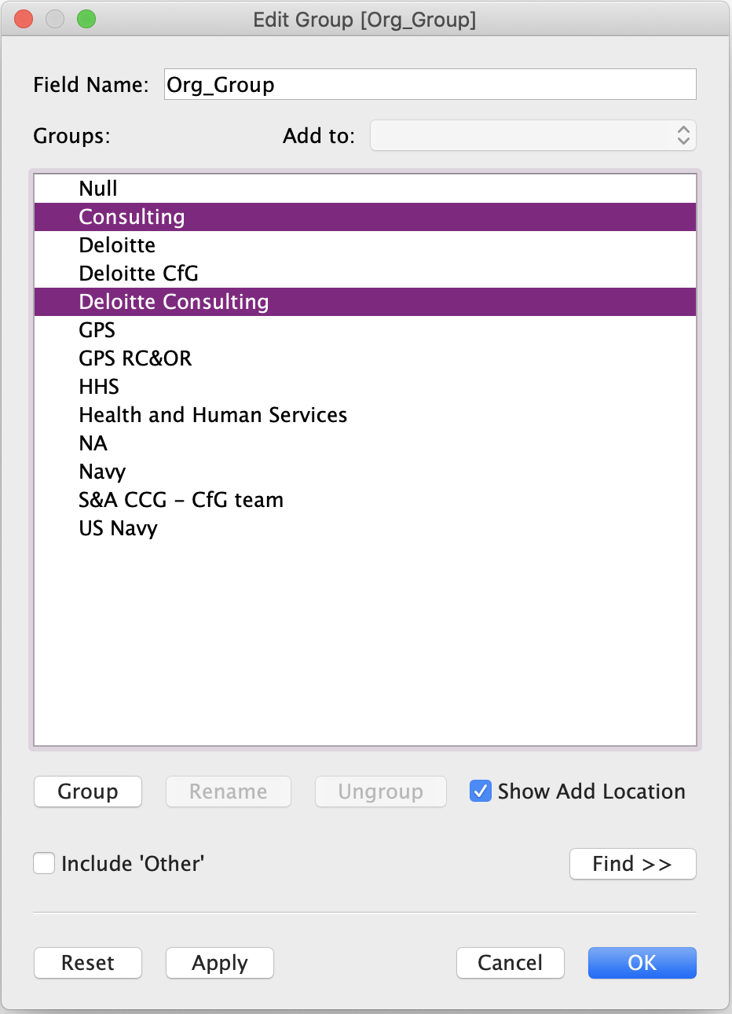
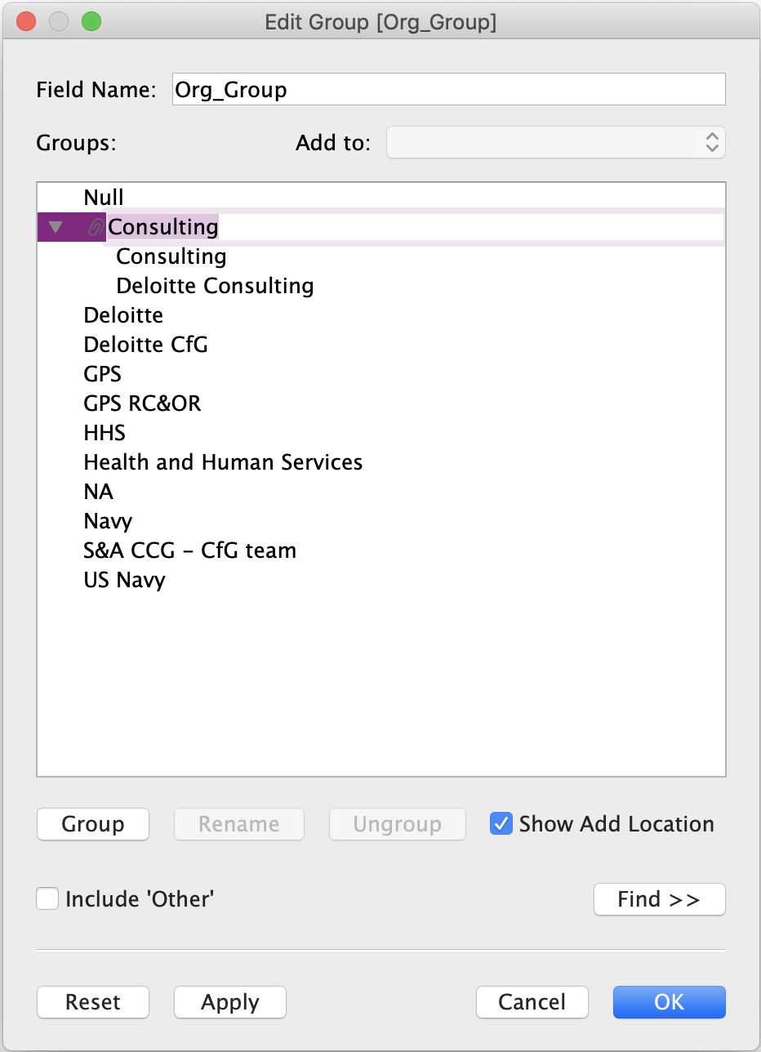
Filters | Organizations Names
CRITICAL ACTION
Using Tableau’s group function to edit organization name data.
Group Organization Names
The source data is the “Organization” data column from Snowflake INTERIM_DATA_2
The existing data source for the filter is the grouped version of the organization data called “Org_Group”
Check “Org_Group” for updates and make edits
Select items to group.
Click the ”Group” button.
Items can be ungrouped or dragged to move between groups.
Rename group label.
This will be the label that appears as an option in the dropdown menu.
Click ”OK” when finished.
Locate ”Org Group” data dimension.
Right click “Edit Group”.

Slide 14
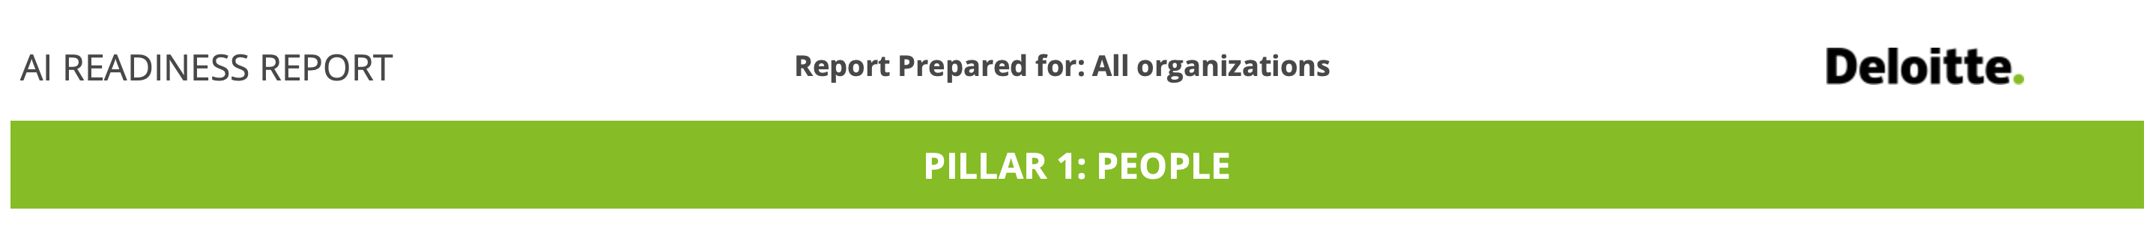
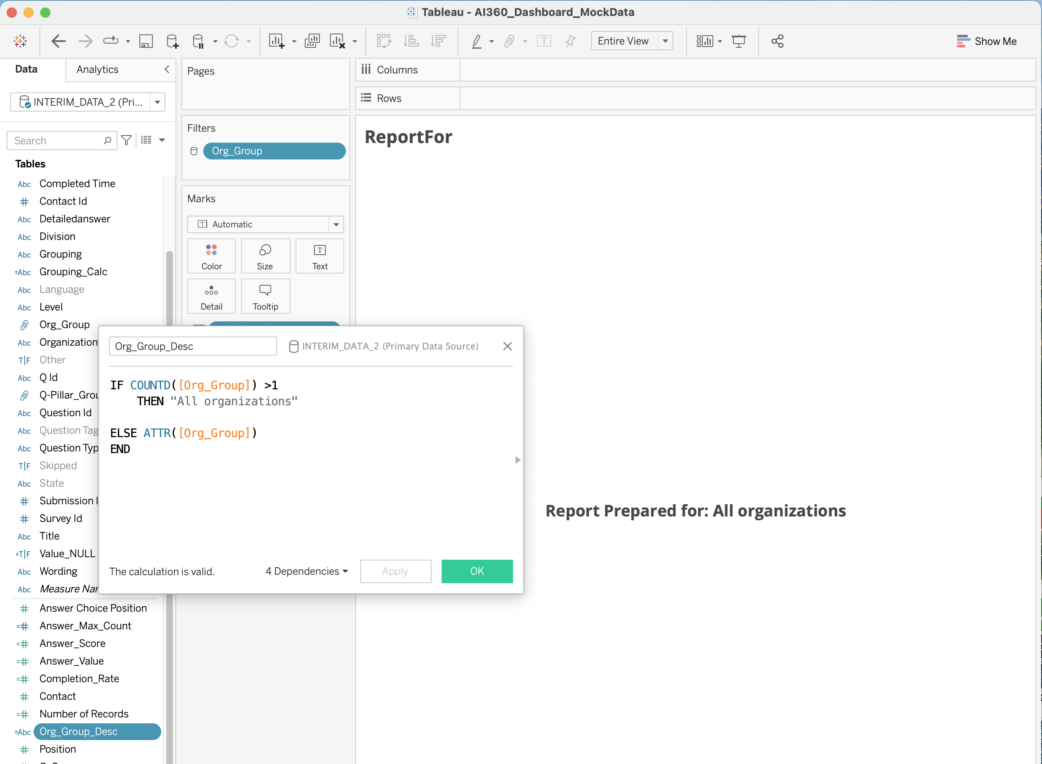
Filters | Organizations Names
Organization name display on dashboards.
Change Data Source
In order to properly display the ”Report Prepared for: …” text at the top of each dashboard, use the “Org_Group_Desc” calculation in the body text of the ”ReportFor” sheet. (Otherwise multiple lines of text will appear when “(All)” is selected from the Organization dropdown menu.)
The “Org_Group_Desc” calculation uses the ”Org_Group” function for organization names.
How the organization name appears at the top of Dashboards 2, 3 and 4.
Calculation used to display organization name.

Slide 15
Tableau Development
Data Visualizations

Slide 16
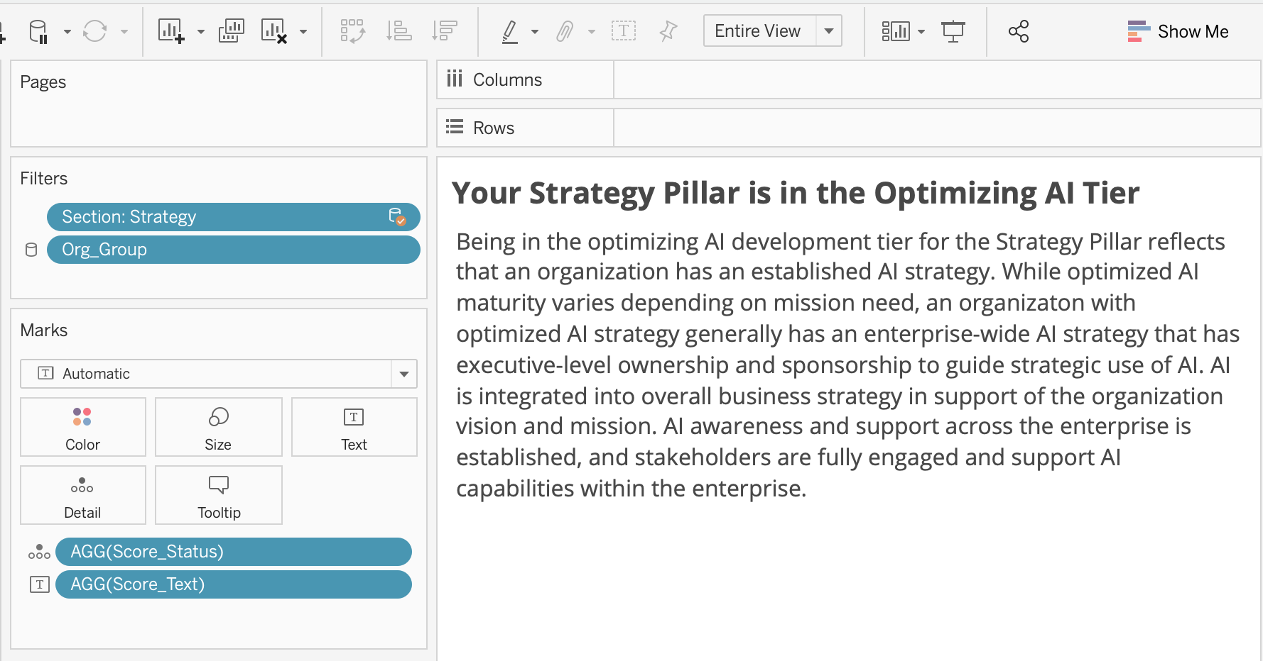
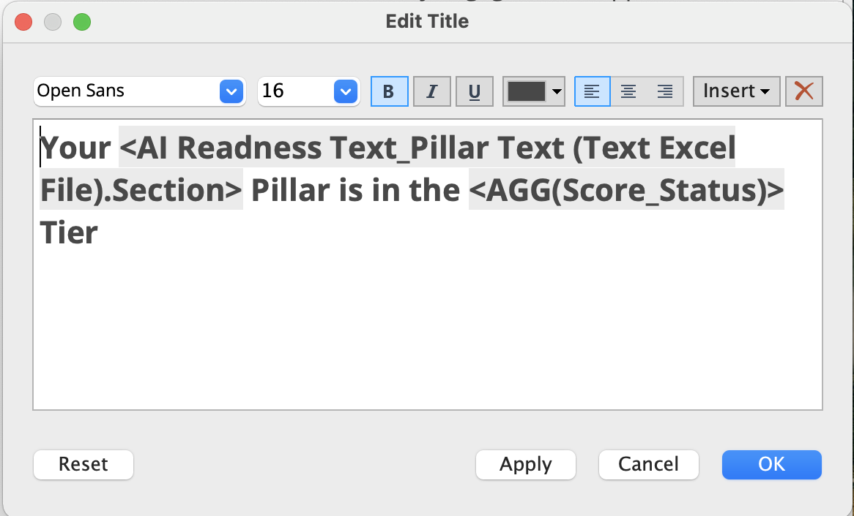
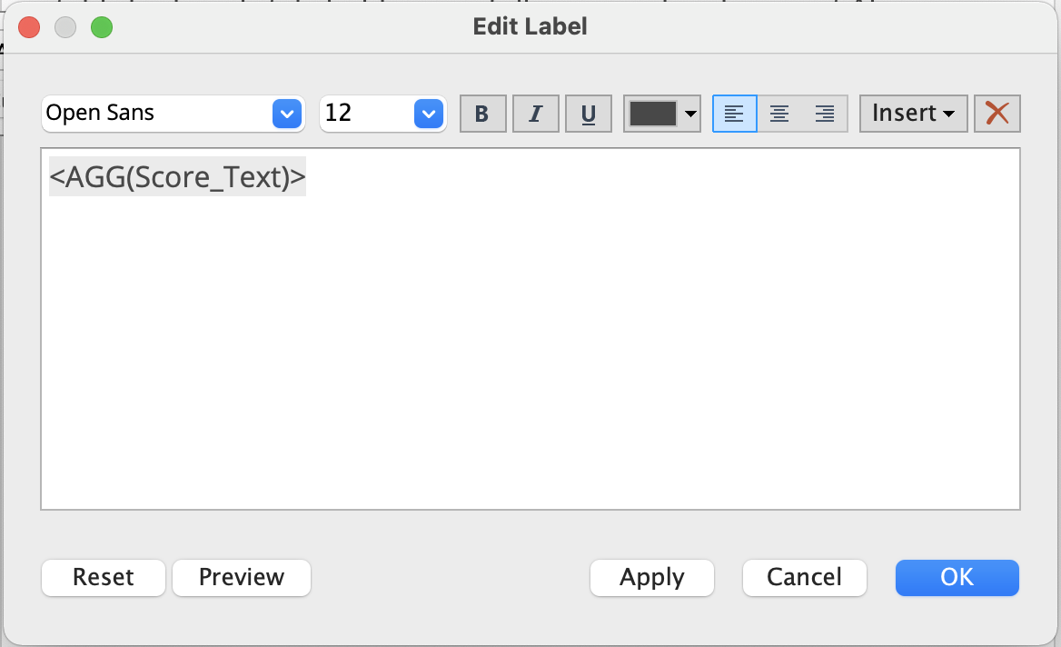
AI Readiness | Pillar Text (1 of 2)
Calculations to display text readout for each pillar.
Pillar Text Settings
The Pillar AI Readiness text draws from the AI Readiness text Excel file based on scores calculated from the survey data.
Filter each sheet for Section (Pillar) and Org_Group.
Use the “Score_Status” calculation in the sheet title, and the “Score_Text” calculation in the body of the sheet.
Pillar text settings and filters.
Title text settings
Body text settings

Slide 17
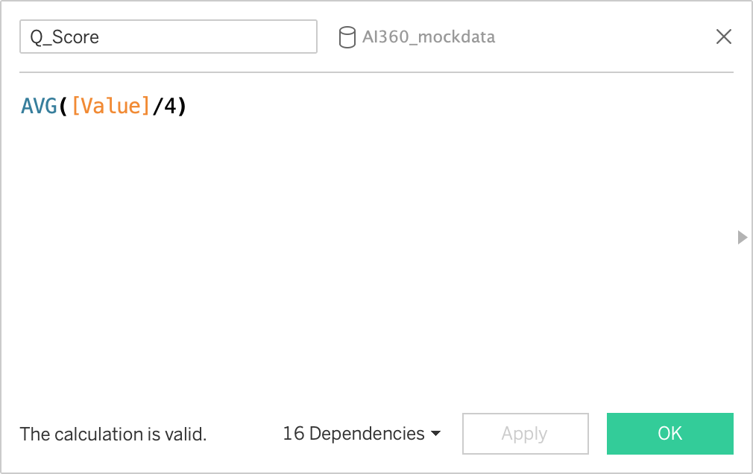
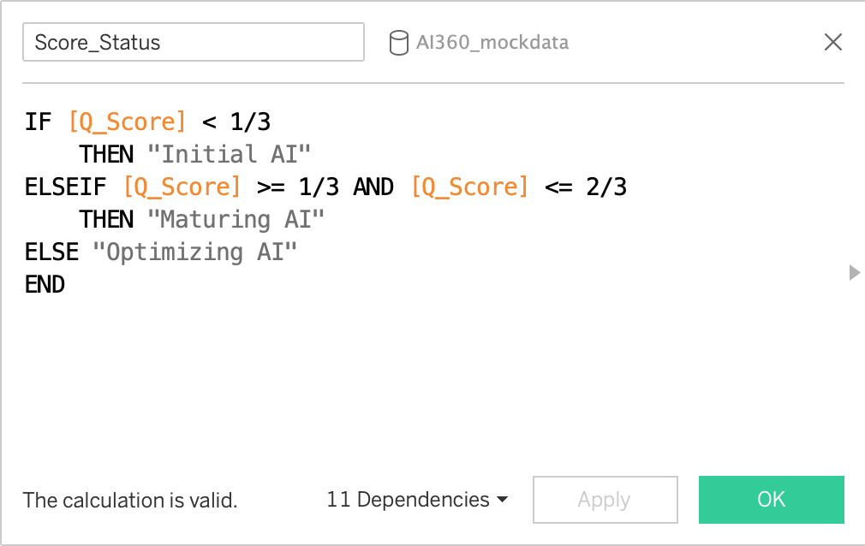
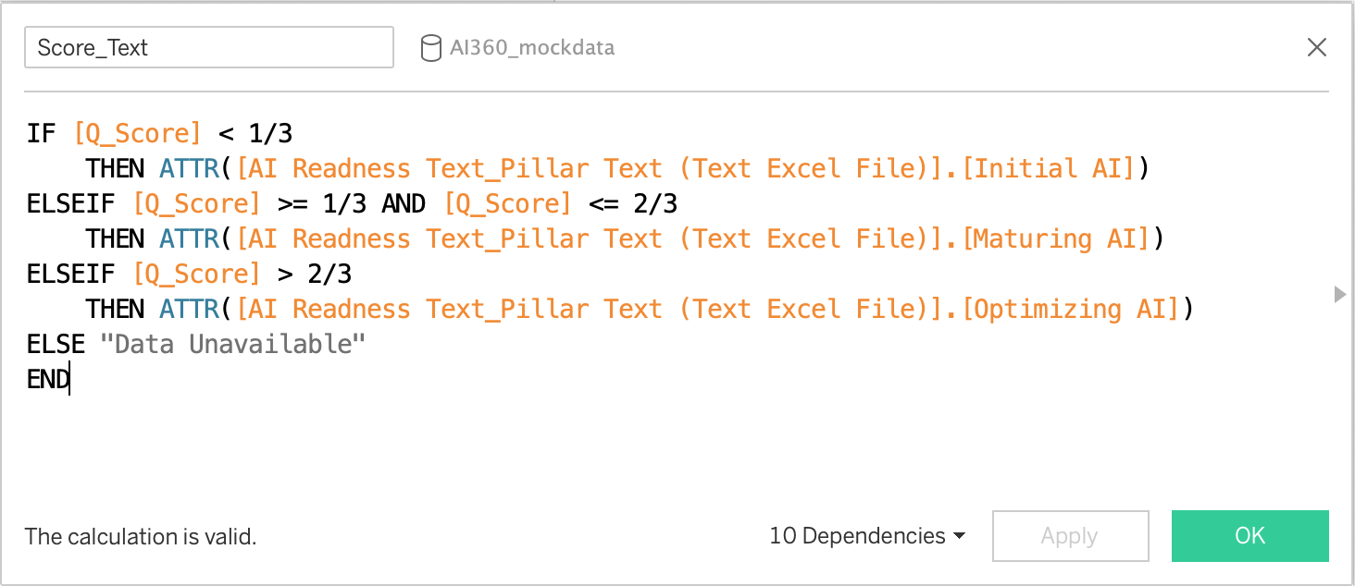
AI Readiness | Pillar Text (2 of 2)
Calculations to display text readout for each pillar.
Pillar Text Settings
Q_Score normalizes the “Value” (numeric value based on survey responses.
Use the “Score_Status” calculation in the sheet title, and the “Score_Text” calculation in the body of the sheet.
Q_Score calculation
Score_Status Calculation used in titles
Score_Text calculation used in body text

Slide 18
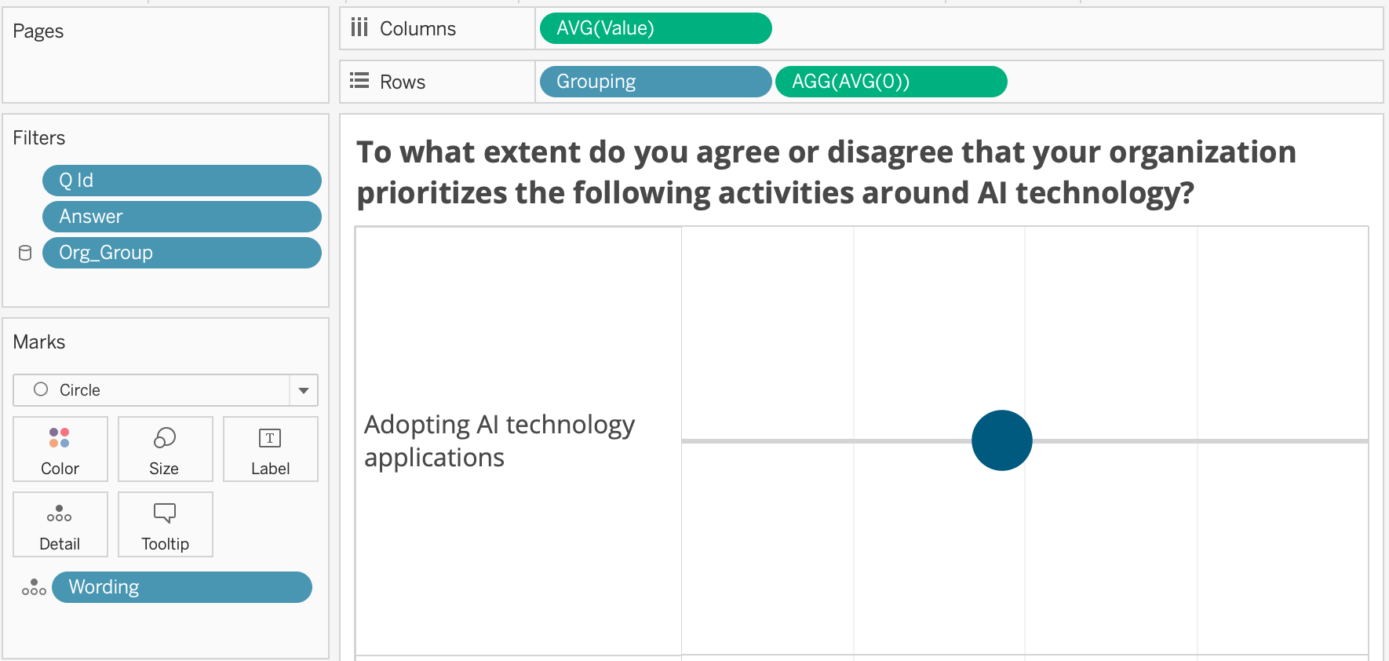
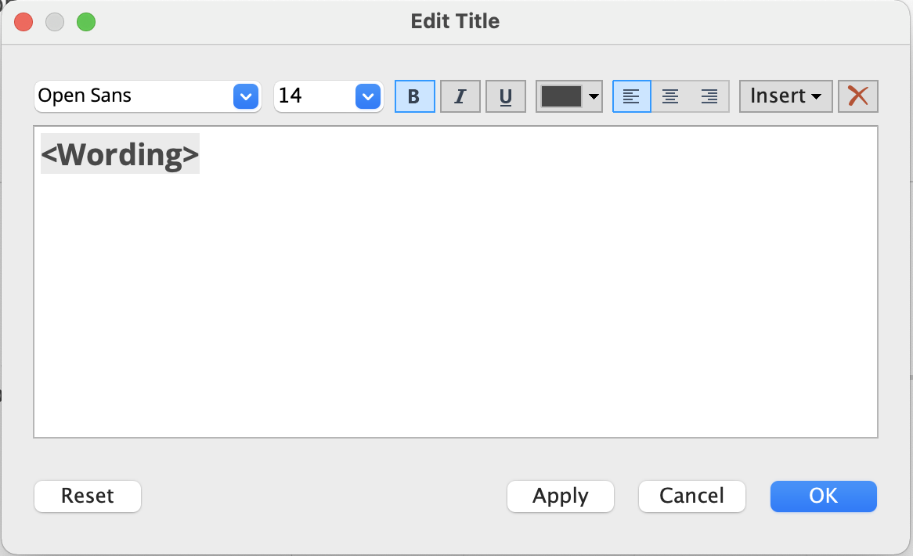
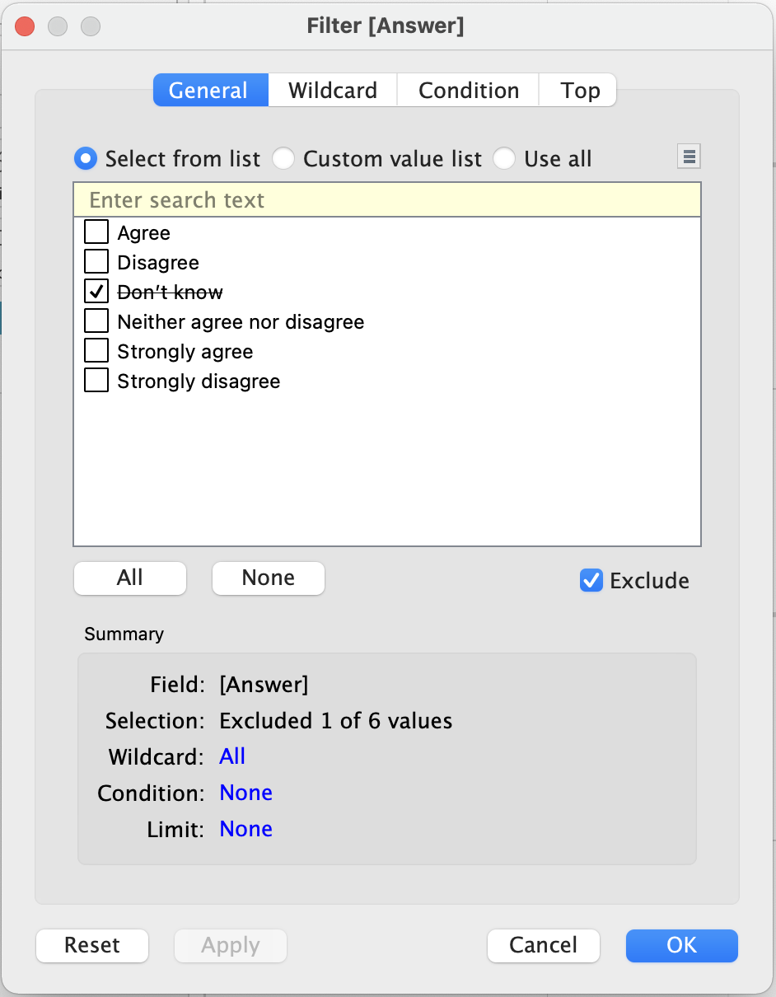
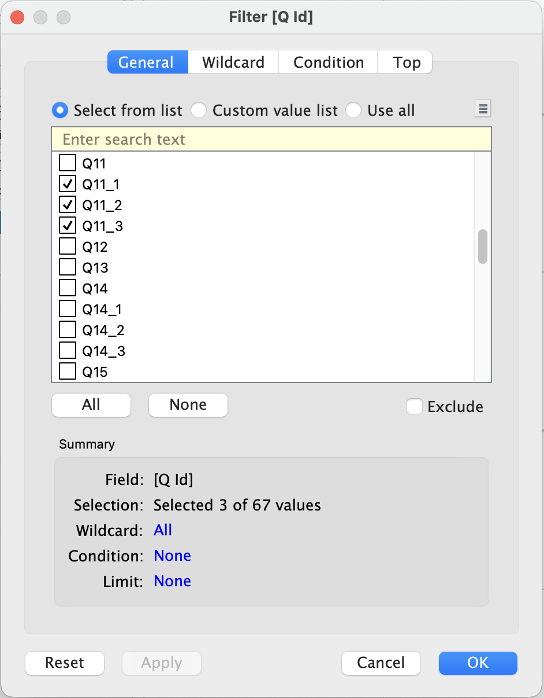
Charts | Slider Charts (1 of 3)
Slider chart set-up and filters.
Slider Chart Filters
The Slider chart is a circle mark based on the Value data (numeric survey response) and a selection of filtes
Column display is based on the AVG(Value).
Rows contain Grouping (text responses from survey). AGG(AVG(0)) is used to place the circle in the vertical center of each row.
Exclude “Don’t know” from the Answer as a precaution to filter out 0 values that can cause bias.
Make sure to check that Q_ID filter is showing the matching survey questions and responses.
Filter and display settings for Slider charts.
“Wording” data is used to display the question in the title
In the Answer filter, exclude “Don’t know”
Make sure the Q_IDs selected are relevant to this section

Slide 19
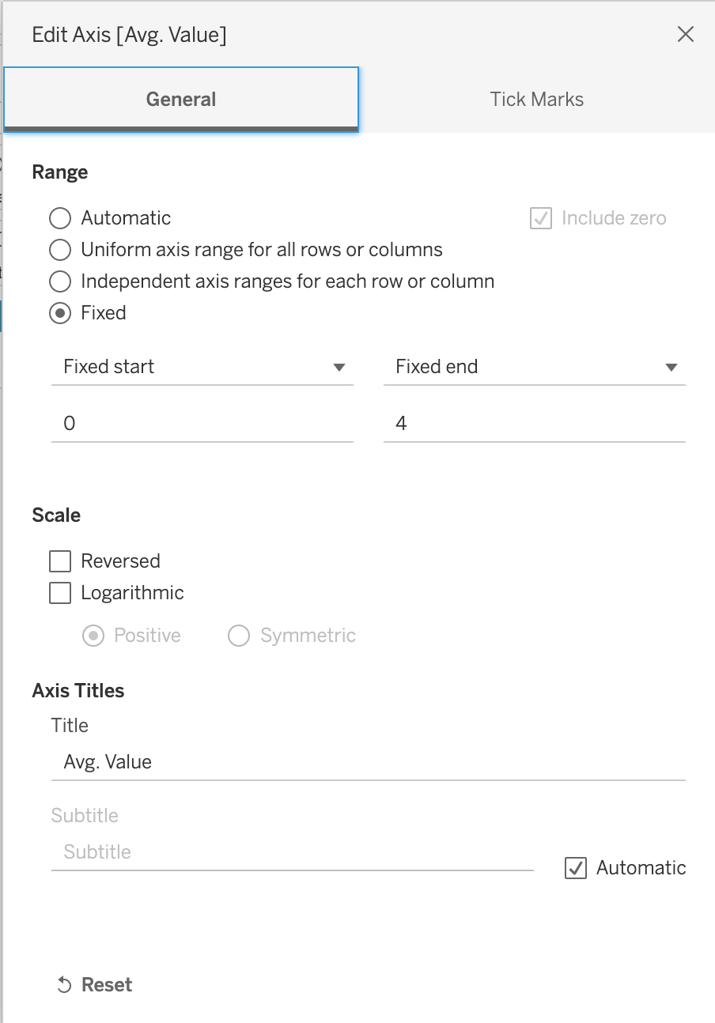
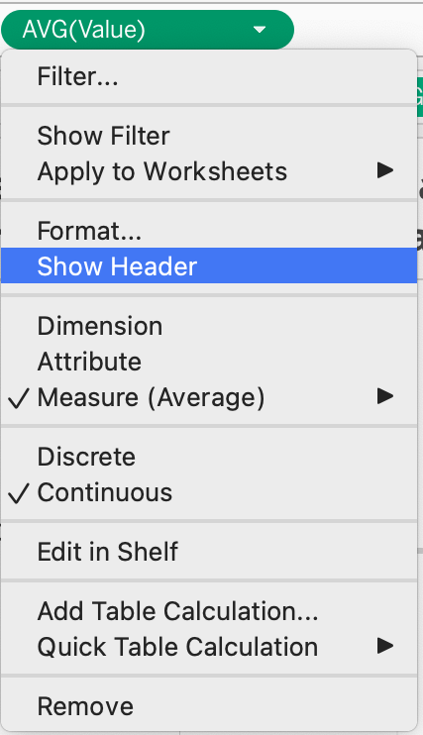
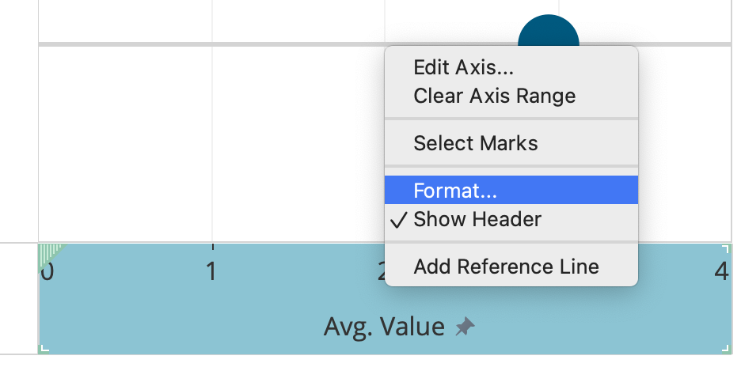
Charts | Slider Charts (2 of 3)
Slider chart set-up and filters.
Slider Chart Display Settings
By default the notebook is set to read a local csv file named “AI350_mockdata”.
To read in live data, connect the notebook to Snowflake.
Filter and display settings for Slider charts.
X Axis Should be set with a Fixed start of 0 and Fixed end of 4.
X Axis displayed. Format X Axis.
Show X Axis by right clicking AVG(Value) in the Columns area and “Show Header”

Slide 20
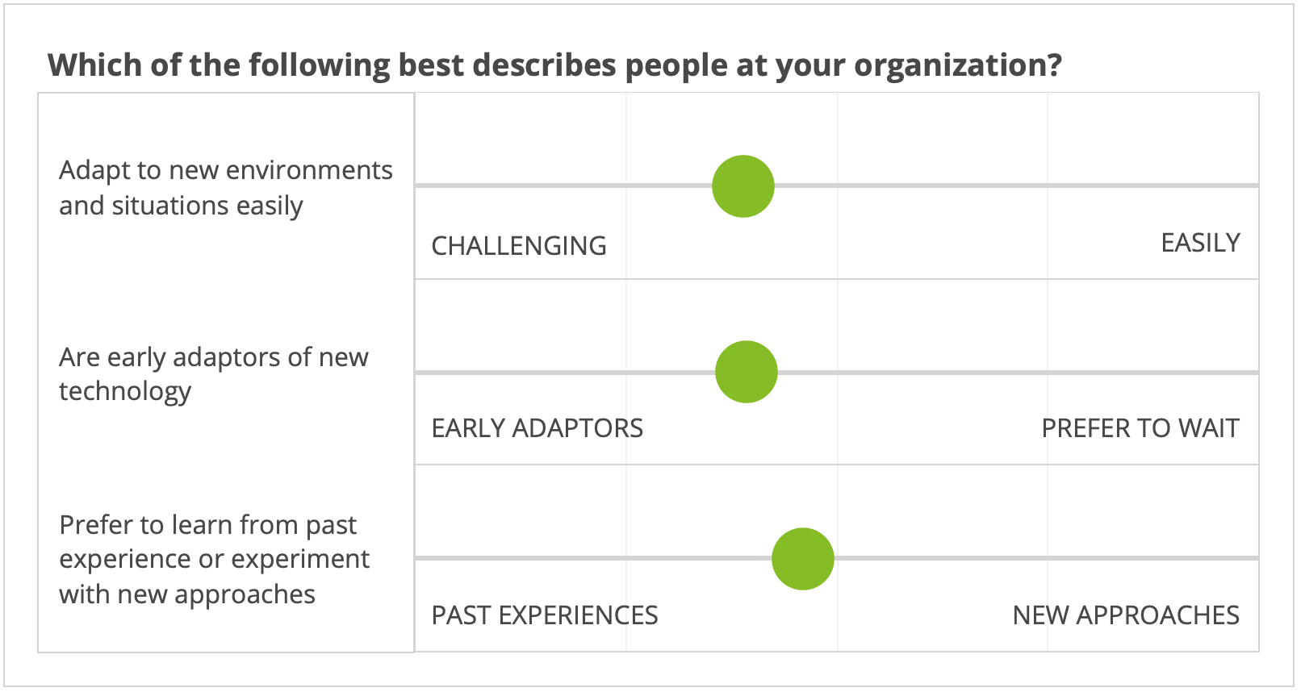
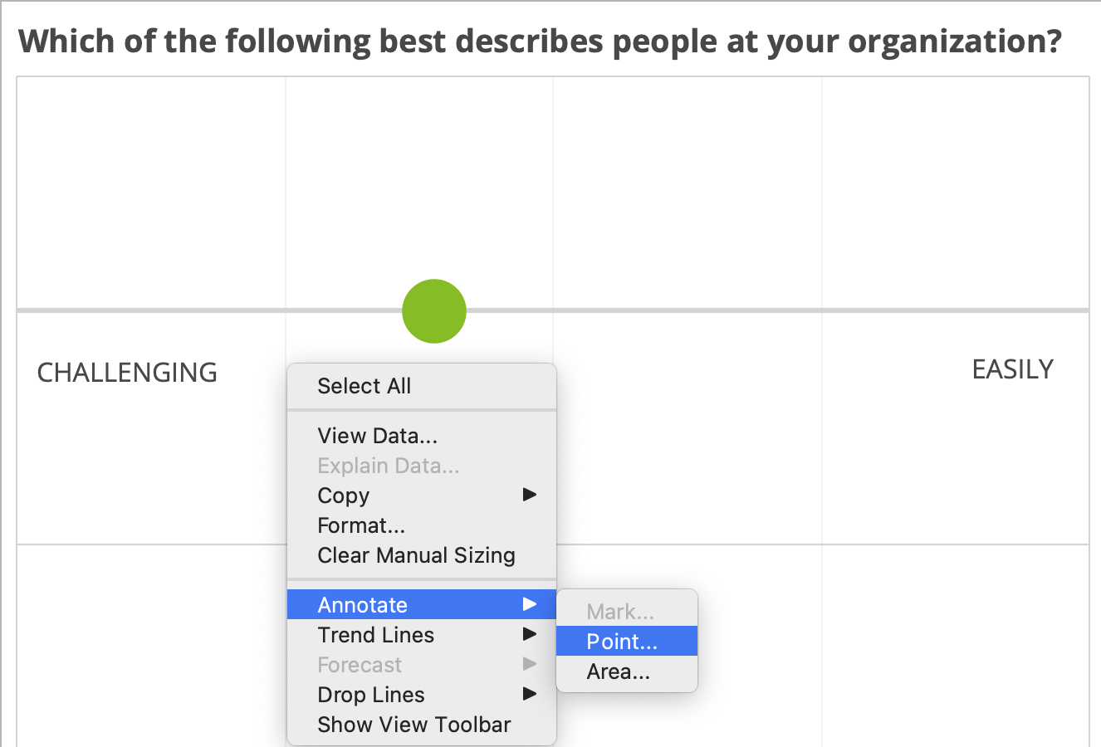
Charts | Slider Charts (1 of 3)
This chart is set up differently than the typical slider chart in this workbook.
Slider Chart Exception
The People_Pillar_Q19 sheet chart is an exception to the standard slider chart. Display settings a different to accommodate a custom style of question and answer format.
Title and text fields are static text boxes.
X Axis text are added as point annotations specific to each row.
Annotation to show custom X axis labels
People_Pillar_Q19 as it appears in the dashboard.
Title and left-hand side text are static text boxes. Review to make sure these are displaying the correct data, text, and X axis labels.

Slide 21
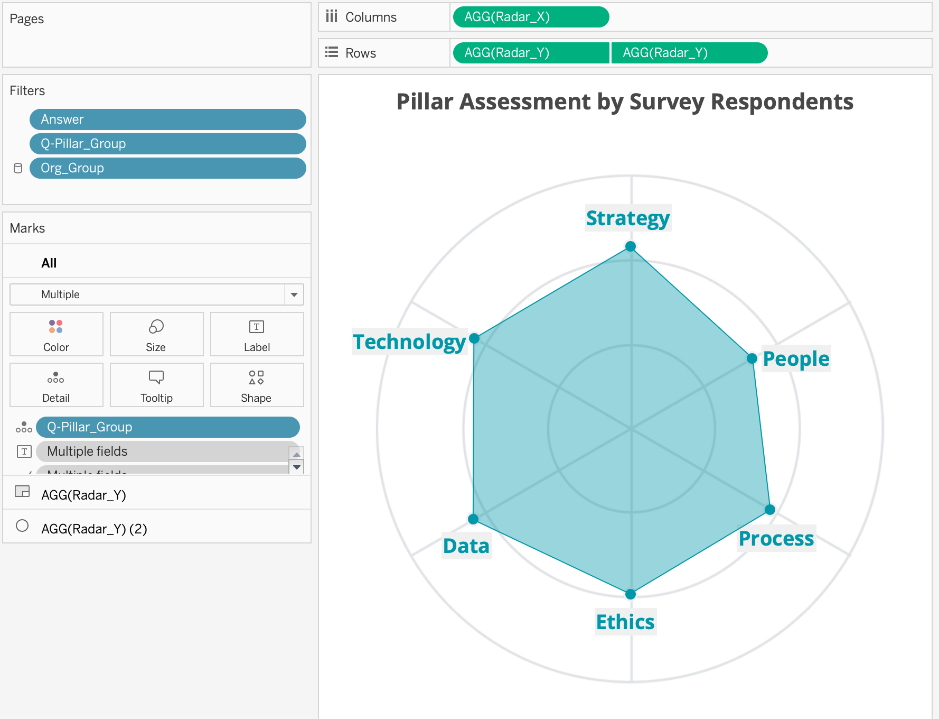
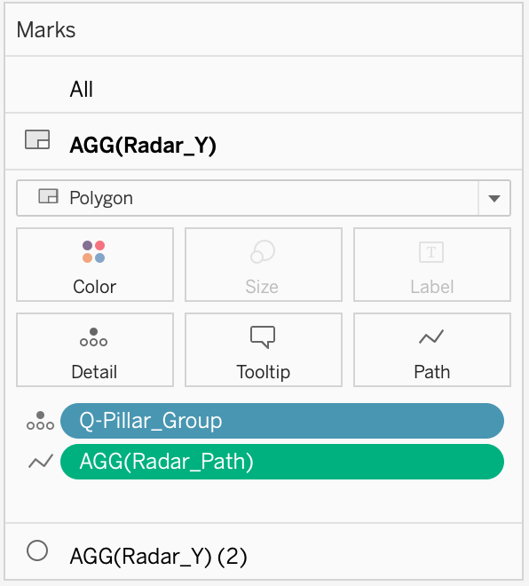
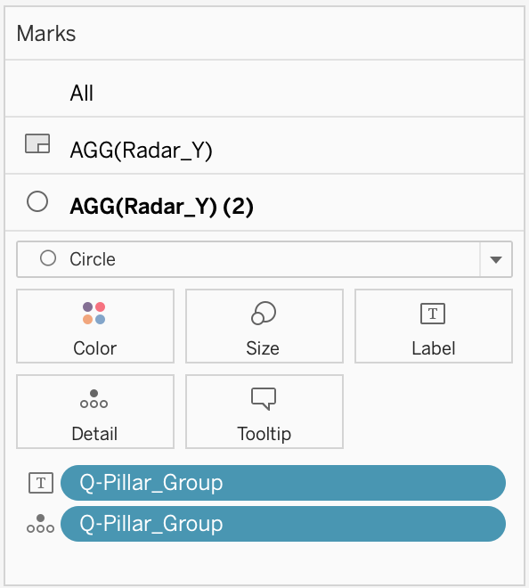
Charts | Radar Chart (1 of 2)
Set-up for Radar chart on Dashboard 1.
Settings and Filters
The radar chart is dependent on Q-Pillar_Group to only display data from selected questions. (Not all survey questions contribute to a Pillar score.)
Custom Radar_X and Radar_Y calculations were used to set points and draw the chart.
The circular axis is a custom mapped image. See tutorial for adding a background image.
Reference this Tableau tutorial to create a radar chart.
Settings for radar chart.

Slide 22
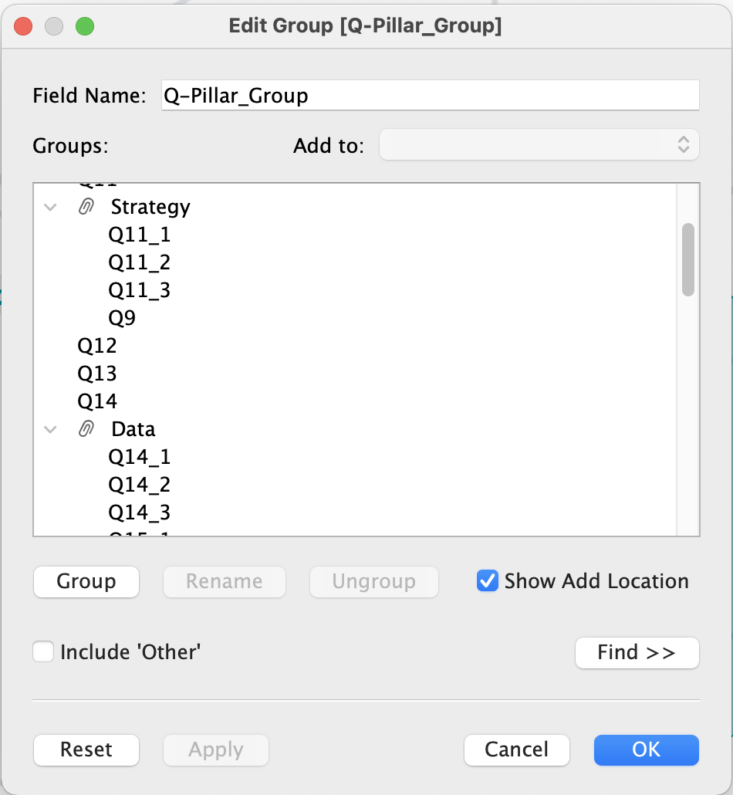
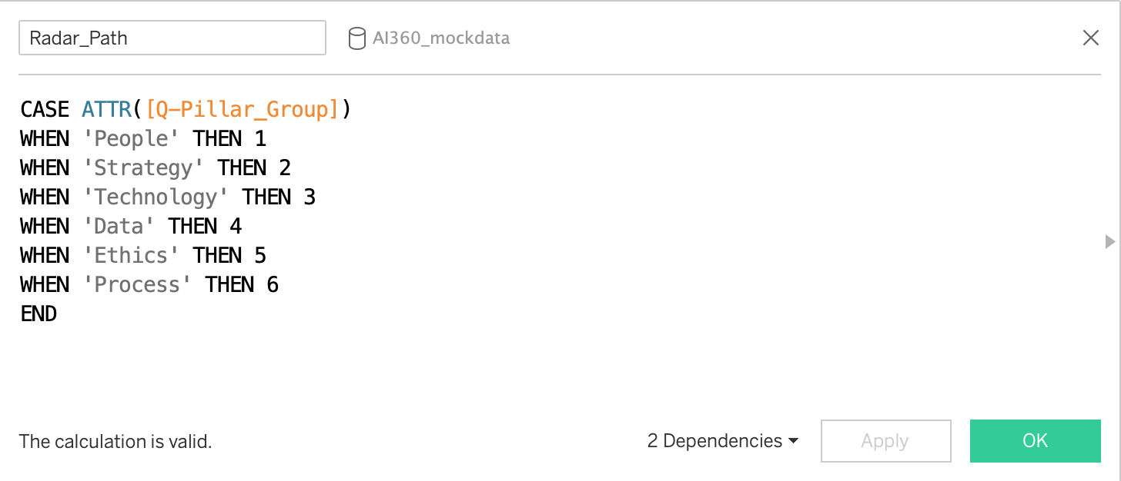
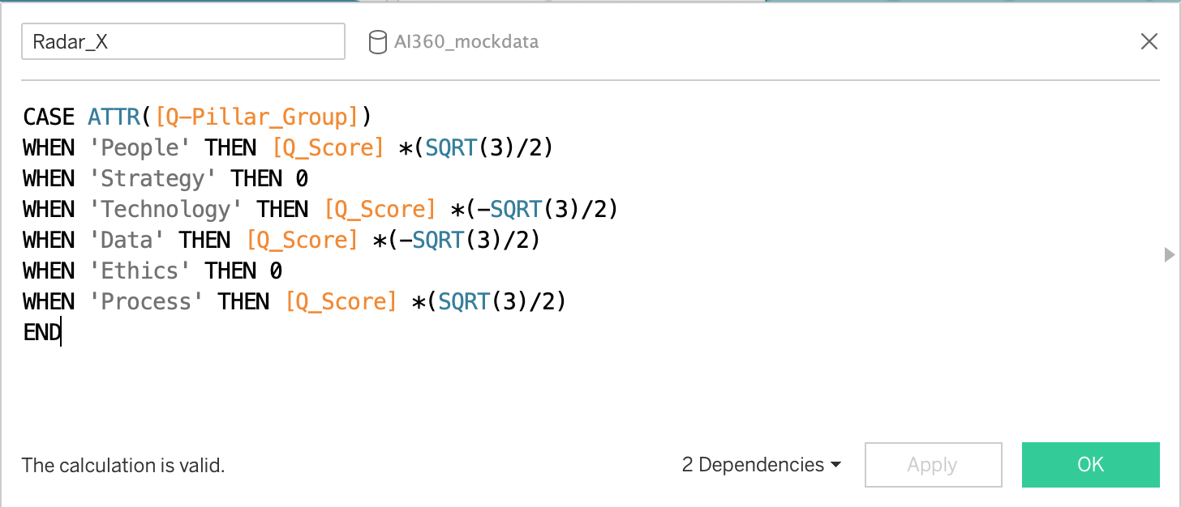
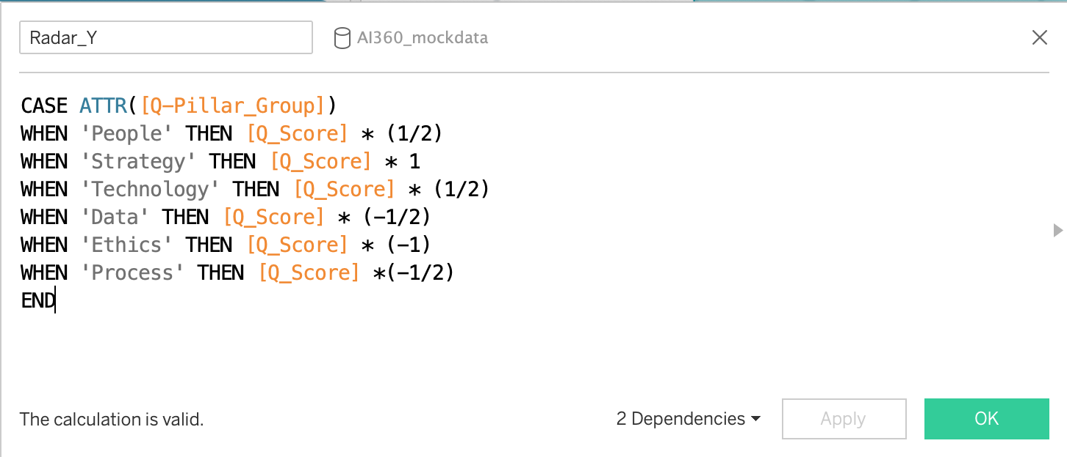
Charts | Radar Chart (2 of 2)
Set-up for Radar chart on Dashboard 1.
Calculations
The radar chart is dependent on Q-Pillar_Group to only display data from selected questions. (Not all survey questions contribute to a Pillar score.)
Custom Radar_X and Radar_Y calculations were used to set points and draw the chart.
The circular axis is a custom mapped image. See tutorial for adding a background image.
Reference this Tableau tutorial to create a radar chart.
Check the Q-Pillar_Group to make sure that the right Q_IDs are associated with each Pillar.
These calculations should remain the same to render the radar chart.

Slide 23
Appendix

Slide 24
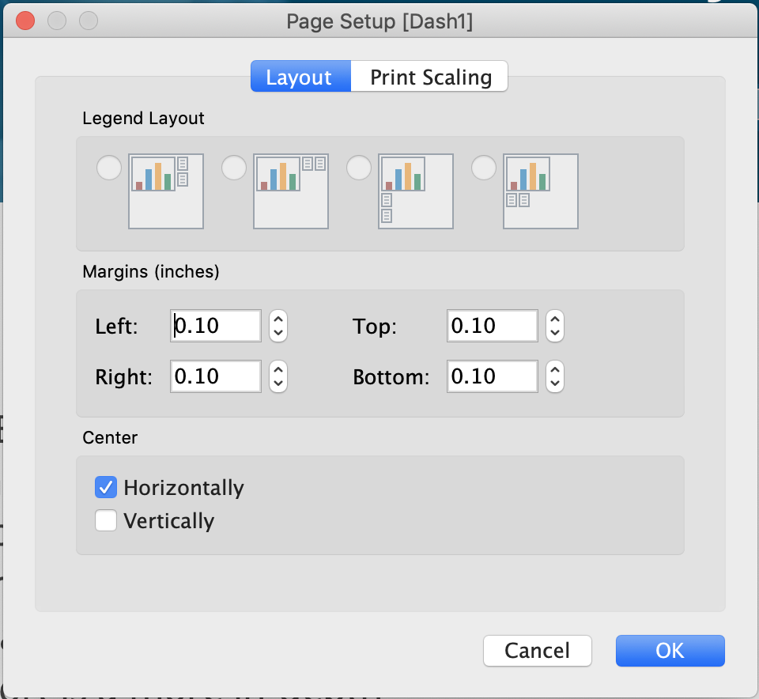
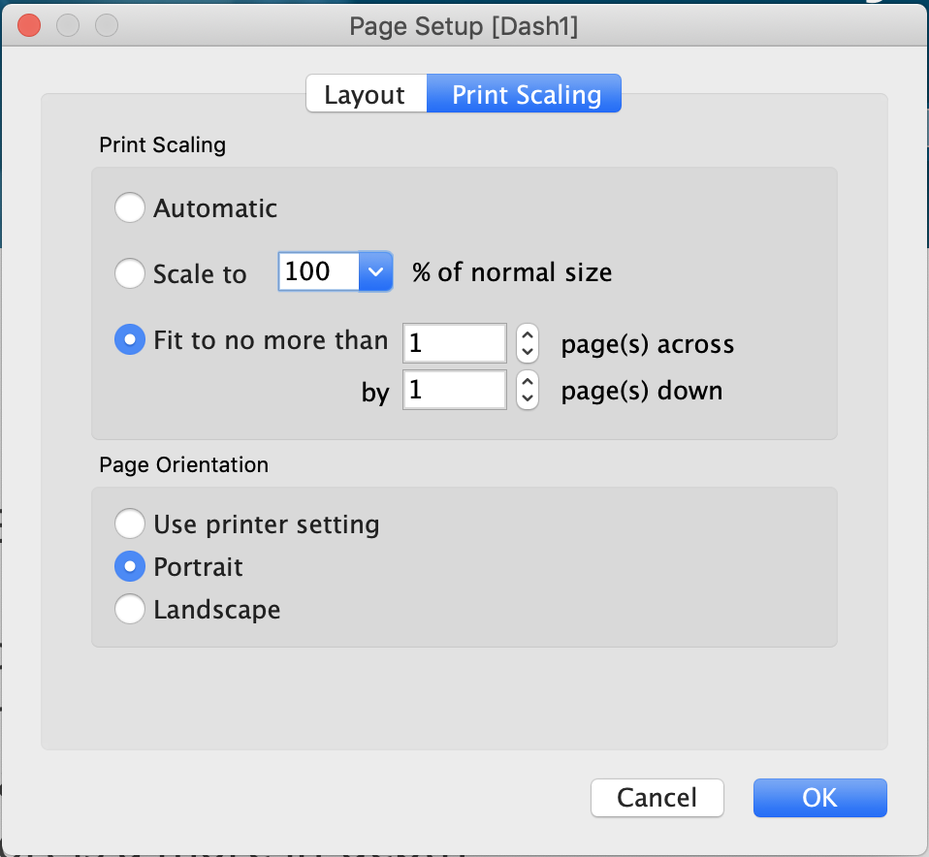
Export Report | Print Settings
Print settings in Tableau for physical printers or to save to PDF.
Layout and Scaling
The Dashboards are set up to fit the width of a standard monitor with proportions to fit a standard letter size page.
Page dimensions: 1440px X 2048px
For best printing result, et Layout margins to 0.10” on all sides. Centered horizontally.
Set Print Scaling to 1 page across by 1 page down.
Set Layout margins equal to 0.10” on all sides. Center Horizontally.
Set printing scale to fit 1 page across by 1 page down.

Slide 25
Tableau Customization | Color Preferences
Custom settings for workbook development.
Preferences.tps
<workbook>
<preferences>
<color-palette name="AI SGO" type="regular" >
<!-- Base Colors -->
<color>#00597F</color>
<color>#86BC25</color>
<color>#3DDCED</color>
<color>#484848</color>
<color>#EAEAEA</color>
<!-- Data and Features Colors -->
<color>#B9D881</color>
<color>#0097A9</color>
<color>#BFA3DC</color>
<color>#8661A8</color>
<color>#EEDE8B</color>
<color>#FBBB18</color>
</color-palette>
</preferences>
</workbook>
Open your Tableau preferences.tps file and add the following color hex codes between the <preferences> tags.

Slide 26
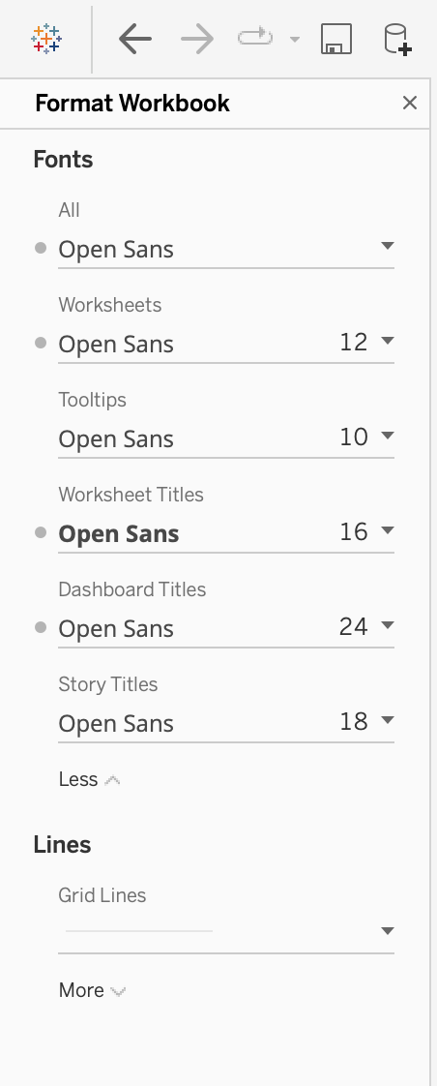
Tableau Customization | Typography
Custom settings for workbook development.
Workbook Settings
Navigate to the Format tab > Format Workbook to make universal typographic changes to the notebook.
Note: User must have Open Sans Regular and Bold fonts installed on their local device in order to view or edit the workbook properly. (This also applies to previewing the workbook on the server.)

Slide 27
Connect to Data| Tableau
Log into Snowflake from Tableau
Change Data Source
By default the notebook is set to read a local csv file named “AI350_mockdata”.
To read in live data, connect the notebook to Snowflake.
SnowflakeODBC driver installation.

